Slide 1

Lecture #2 Video Display Devices

Slide 2
Random Scan (Vector Scan)
In this technique, the electron beam is directed only to the part of the screen where the picture is to be drawn rather than scanning from left to right and top to bottom as in raster scan.
It is also called vector display, stroke-writing display, or calligraphic display.

Slide 3
Working of Random Scan
To display a specified picture, the system cycles through the set of commands in the display file, drawing each component line in turn.
After all the line-drawing commands are processed, the system cycles back to the first line command in the list.
Random-scan displays are designed to draw all the component lines of a picture 30 to 60 times each second.

Slide 4
Raster Scan
In a raster scan system:
The electron beam is swept across the screen, one row at a time from top to bottom.
As the electron beam moves across each row, the beam intensity is turned on and off to create a pattern of illuminated spots.

Slide 5
Cont.
Picture definition is stored in memory area called the Refresh Buffer or Frame Buffer.
This memory area holds the set of intensity values for all the screen points.
Stored intensity values are then retrieved from the refresh buffer and “painted” on the screen one row (scan line) at a time as shown in the following illustration.

Slide 6
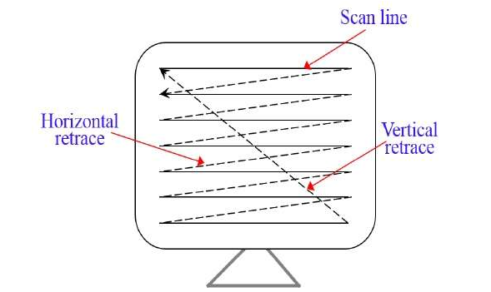
Cont…

Slide 7
Cont….
Each screen point is referred to as a pixel (picture element) or pel. At the end of each scan line, the electron beam returns to the left side of the screen to begin displaying the next scan line.

Slide 8

Flat panel display
Flat panel displays encompass a growing number of electronic visual display technologies. They are far lighter and thinner than traditional sets and video displays that use cathode ray tubes (CRTs), and are usually less than 10 centimeters (3.9 in) thick.

Slide 9
FPD
FPDs emit less radiation, produce less screen flicker and consume less power.
They also take up less space, allowing for a more comfortable work environment.
Emissive (Converts Electronic Energy into light)
Plasma Panel Display
Light Emitting Diodes (LED)
Non Emissive (Use External Sources)
Liquid Crystal Display

Slide 10
Plasma Panel Display
A type of flat-panel display that works by sandwiching a neon/xenon gas mixture between two sealed glass plates with parallel electrodes deposited on their surfaces.
The plates are sealed so that the electrodes form right angles, creating pixels.
When a voltage pulse passes between two electrodes, the gas breaks down and produces weakly ionized plasma, which emits UV radiation.
The UV radiation activates color phosphors and visible light is emitted from each pixel.

Slide 11
Liquid Crystal Display
A liquid crystal display (LCD) monitor is a computer monitor or display that uses LCD technology to show clear images, and is found mostly in laptop computers and flat panel monitors.

Slide 12
How LCD works?
An LCD monitor is essentially composed of 3 parts:
A white backlight. This provides the light for the monitor, since the other components only serve as filters.
A layer of liquid crystal cells. These cells are composed of:
Two polarizing layers, one on either side with perpendicular orientations. Without the liquid crystal, perpendicular polarizing layers block all light.
Transparent electrodes, to turn the liquid crystal on or off to varying degrees.
Liquid crystals, which block light to varying degrees based on the voltage of the electrodes, when combined with the polarizing layers.
Red, blue and green color filters placed on top of each cell (sub-pixel), so that different colors can be produced.

Slide 13
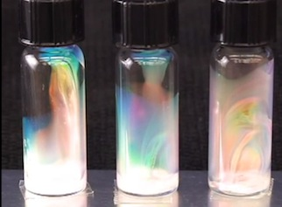
Liquid Crystal

Slide 14
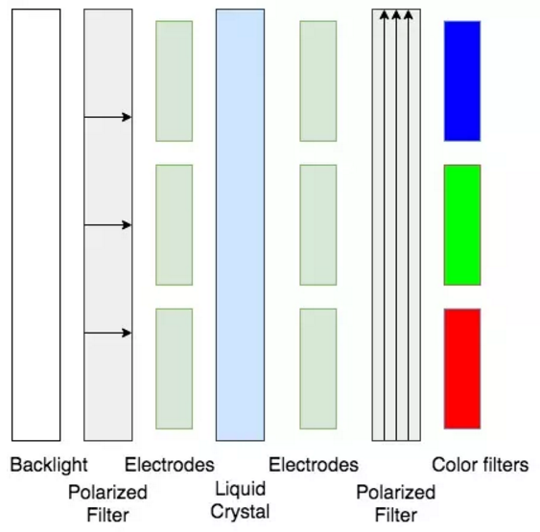

Slide 15
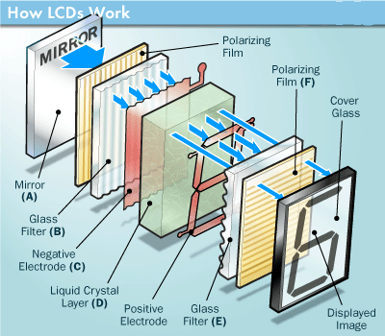

Slide 16
Light Emitting Diodes
An LED display panel can be either a small display or part of a larger display.
LED diodes are used in order to make up an LED display.
LED displays are also used in billboards and store signs.
An LED panel consists of several LEDs, whereas an LED display consists of several LED panels.
LEDs used in order to make up LED displays offer several advantages in comparison to other light emitting sources.
A light emitting diode is made up of a semiconductor chip which is surrounded by a transparent plastic case.
The plastic case allows the light to pass through it.

Slide 17
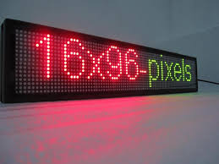
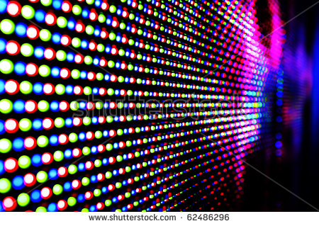
LED

